Slide 1
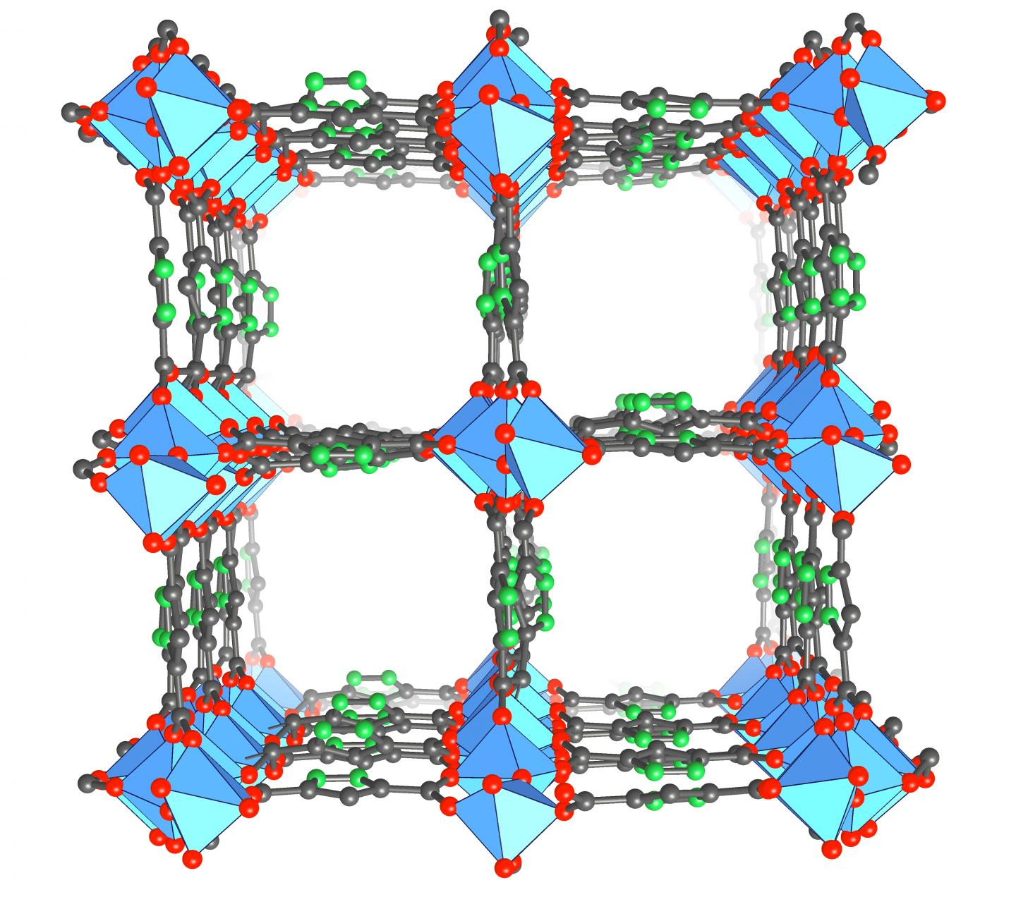
DFT and periodic systems
“How Chemistry and Physics Meet in the Solid State” – Roald Hoffmann, Angew Chemie 26 (1987) 846-878
“Iterative minimization techniques for ab initio total energy calculations: molecular dynamics and conjugate gradients” – Payne et al., Reviews of Modern Physics, 64 (1992) 1045
June 14, 2022

Slide 2
What systems might we be interested in that are periodic?
?

Slide 3
What systems might we be interested in that are periodic?
3D - solids
metals, metal oxides, carbon, semiconductors,
1D and 2D:
carbon nanotubes, graphene, surfaces

Slide 4
What properties might we want to calculate?
?

Slide 5
What properties might we want to calculate?
Phase diagrams (oxidation, mixing)
Compression/expansion
Cohesive energies
Electronic properties (conductivity, excitation energies/absorption spectra)
Surfaces – adsorption of molecules, reactivity

Slide 6
Electronic structure calculations on periodic systems (think, “solids”) will include some differences in execution
Specifying the structure of a solid requires basis vectors and a basis (ie, a “unit cell”) (familiarity?)
The number of atoms in a solid is effectively infinite – our code needs to express the periodicity of the potential (ie, an atom in a “unit cell” needs to feel those not in its “unit cell”)
Electron density is not (necessarily) near our atoms and exponentially decaying as we move away from them, as in a molecule. In a solid, atoms and electrons fill (most) space. Unclear if it is computationally most efficient to use atomic orbitals as our basis set.

Slide 7
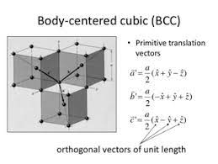
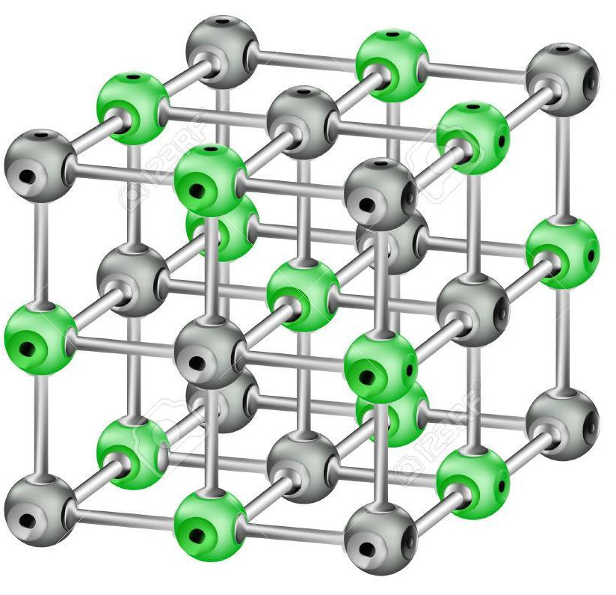
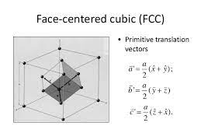
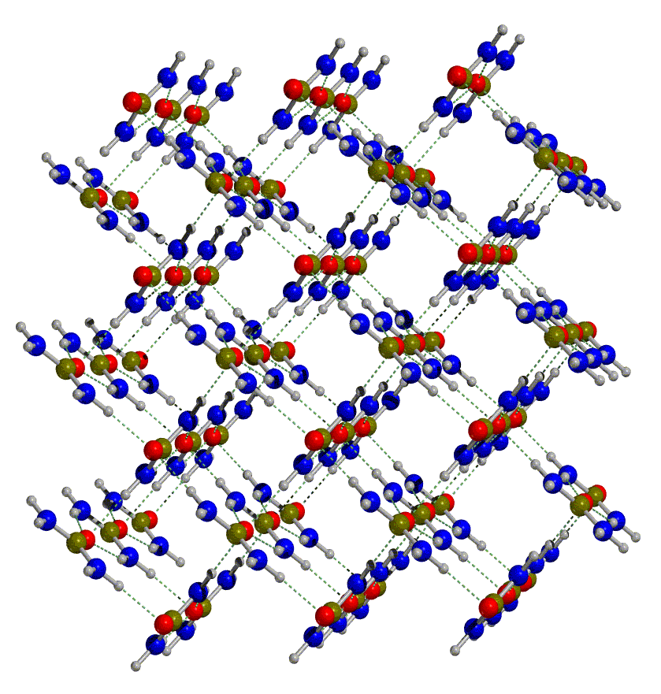
Specifying the structure of a solid requires basis vectors and a basis (ie, a “unit cell”) → 3D
Download from Materials Project, OQMD, AFlowLib….

Slide 8
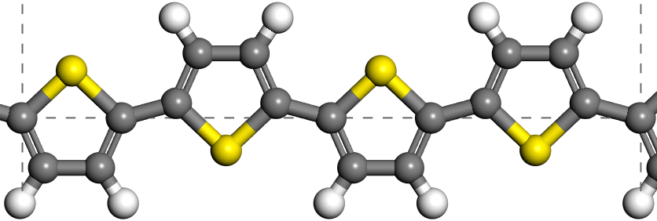
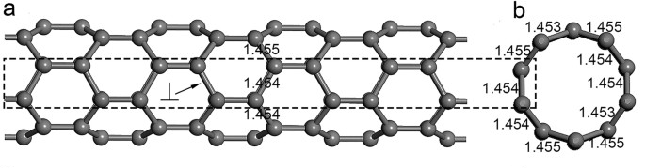
Specifying the structure of a solid requires basis vectors and a basis (ie, a “unit cell”) → 1D
For 1D – one basis vectors repeats the system, the other 2 are made large enough to avoid interaction between repeated cells (because the code is typically 3D periodic)
How to handle 2D?

Slide 9
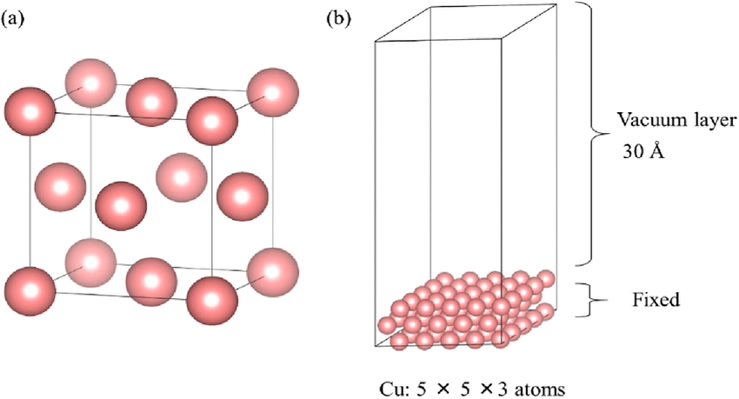
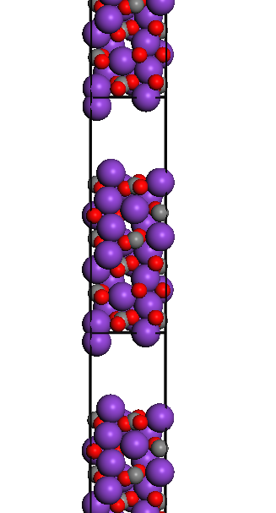
Specifying the structure of a solid requires basis vectors and a basis (ie, a “unit cell”) → 2D
For a surface – 2 basis vectors tell how the atoms in our surface repeat, and the third is long to avoid interaction between period cells.
Subtleties – long is long enough? Hard if surface has a big dipole moment, then interaction is long range. Codes include correction approaches….

Slide 10
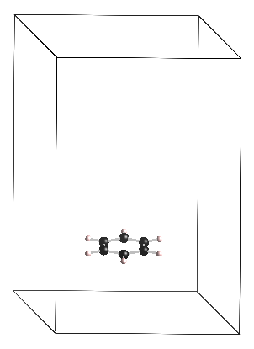
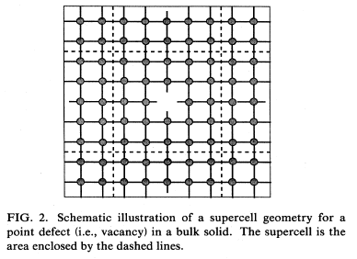
We can add non-periodic features by making repeats long enough that whatever is not periodic doesn’t interact (0D)
A low concentration defect (vacancy in picture, could be dopant, dislocation, etc) in a solid

Slide 11
Electronic structure calculations on periodic systems (think, “solids”) will include some differences in execution
Specifying the structure of a solid requires basis vectors and a basis (ie, a “unit cell”) (familiarity?)
The number of atoms in a solid is effectively infinite – our code needs to express the periodicity of the potential (ie, an atom in a “unit cell” needs to feel those not in its “unit cell”)
Electron density is not (necessarily) near our atoms and exponentially decaying as we move away from them, as in a molecule. In a solid, atoms and electrons fill (most) space. Unclear if it is computationally most efficient to use atomic orbitals as our basis set.

Slide 12
2) The number of atoms in a solid is effectively infinite – our code needs to express the periodicity of the potential
Ewald summation, math – can express the infinite number of interactions in periodic cells in terms unit vectors

Slide 13
Electronic structure calculations on periodic systems (think, “solids”) will include some differences in execution
Specifying the structure of a solid requires basis vectors and a basis (ie, a “unit cell”) (familiarity?)
The number of atoms in a solid is effectively infinite – our code needs to express the periodicity of the potential (ie, an atom in a “unit cell” needs to feel those not in its “unit cell”)
Electron density is not (necessarily) near our atoms and exponentially decaying as we move away from them, as in a molecule. In a solid, atoms and electrons fill (most) space. Unclear if it is computationally most efficient to use atomic orbitals as our basis set. (And other complexities of representing a periodic electronic structure…..)

Slide 14
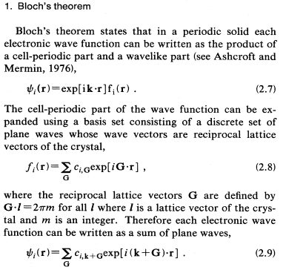
Bloch’s Theorem – Write the wavefunction as a product of a cell periodic part and a wave-like part
f_{i}(r) is effectively what we did yesterday – a wavefunction around the atoms in our system (now, in our “unit cell”)
2.8 – come back to this, but says we can use “plane waves” rather than atomic orbitals for f
The Hoffmann paper helps us understand the “cell-periodic part”

Slide 15
Familiarity with “band structure” of a solid?
?

Slide 16
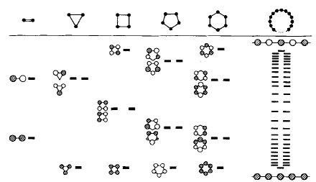
In solids, the “repeated bonding” of many atoms to each other produces bands of states (orbitals) differing slightly in energy
“How Chemistry and Physics Meet in the Solid State” – Roald Hoffmann, Angew Chemie 26 (1987) 846-878
ψ = c₁ φ₁ + c₂ φ₂
The circle is f_{i}(r) – a s orbital centered on an atom (ie, φ_{I} → today we will use χ to steal from Hoffmann paper)

Slide 17

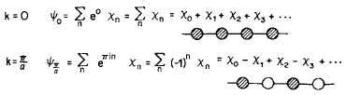

A 1-dimensional H-chain helps us think about how we might mathematically express these states
H ---- H ---- H ---- H ---- H ---- H
a
$${χ }_{n}$$
= 1s Orbital
When you see e^{iy} , think sin (y)
Note e⁰ = 1 and therefore k=0 just gives a constant 1
e^{iπn} = -1^{n}

Slide 18





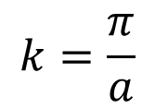







What the orbitals look like at different k, and the “band structure” this leads to…..
$$Ψ=e^{ikx }f(x)$$
$$a$$
Periodic function
Plane wave $\sim cos⁡(kx)$
Wave vector $→k=\frac{2π}{λ}$
$$λ$$
$$P=\left|Ψ^{2}\right|$$
$$k=0$$
$$a$$
E(k)
$$λ=∞$$
E
$$k=\frac{π}{a}$$
$$λ=2a$$
0
Wave vector $k$
$$π/a$$

Slide 19
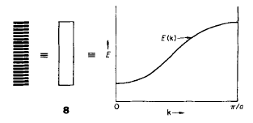
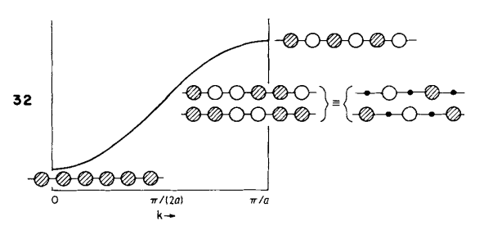
A “band” is then a number of states close together in energy that differ in “k”

Slide 20





Bands fold upon doubling the unit cell
E
E
0
$$π/2a$$
$$π/a$$
0
$$π/2a$$
Wave vector k
Wave vector k
$$a$$
$$a$$

Slide 21
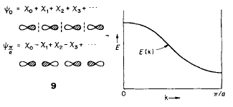
“See how they run” – the variation of energy with k tells us something about the orbital character, band identify

Slide 22
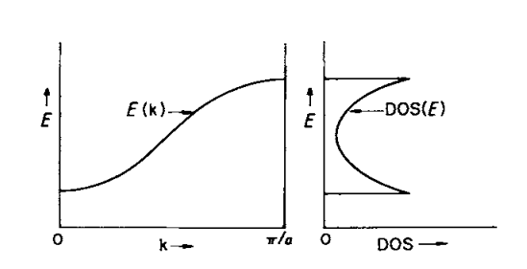
A “density of states” plot shows us how many orbitals we have at each energy

Slide 23
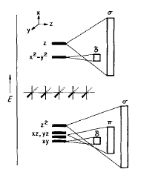
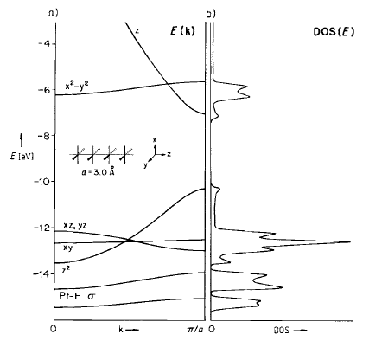
Orbital diagram becomes a “Density of states” plot
but back to periodic DFT calculations (Payne et al.)…….

Slide 24
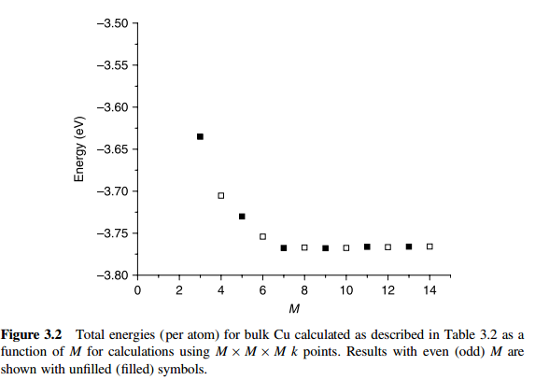
K Point Sampling – energy will converge as more k-points included
Not always monotonic like this graph

Slide 25
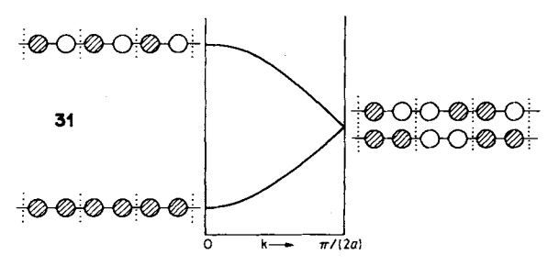
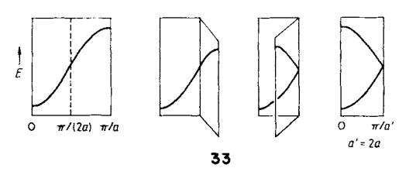
A bigger cell (longer basis vector) means we need less k-points to converge our k-point sampling
2a

Slide 26
Bloch’s Theorem – Write the wavefunction as a product of a cell periodic part and a wave-like part
f_{i}(r) is effectively what we did yesterday – a wavefunction around the atoms in our system (now, in our “unit cell”)
2.8 – come back to this, but says we can use “plane waves” rather than atomic orbitals for f
The Hoffmann paper helps us understand the “cell-periodic part”

Slide 27
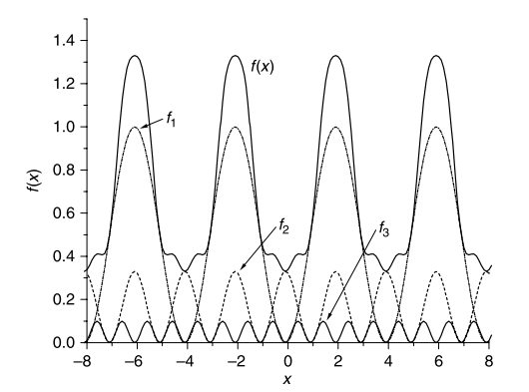
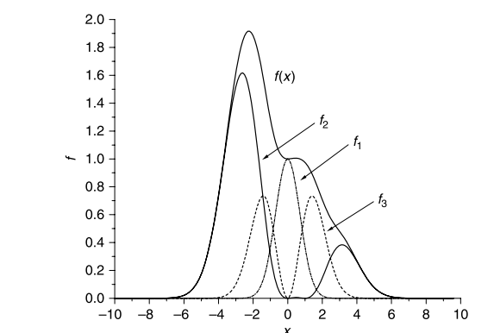
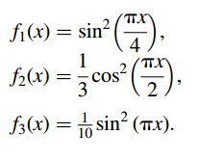
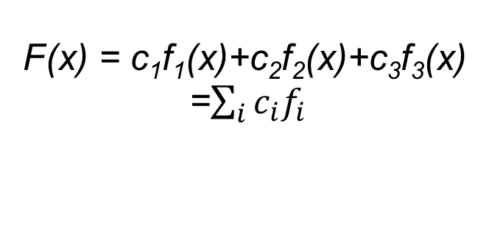
Rather than localized (atomic orbital) basis sets, we can use plane waves (ie, “Fourier series) for ψ
F(x) = c₁f₁(x)+c₂f₂(x)+c₃f₃(x)
=$\sum_{i}{c_{i}f_{i}}$

Slide 28
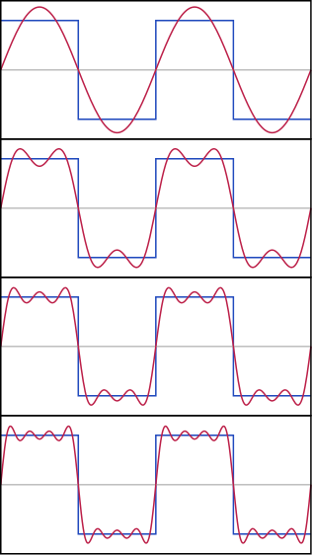
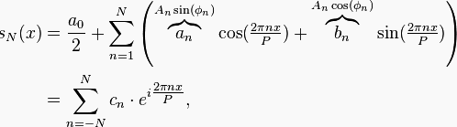
Fourier Series and Plane Waves used to represent ψ
ψ

Slide 29
Periodic density functional theory: plane-wave basis sets and k-point sampling
Bloch theorem: at each k-point, the wave function can be written as an infinite set of “plane-waves.” (If “plane-waves” bothers you – think “sine waves,” ie, expanded in a Fourier series).
The problem then reduces to solving for the coefficients in the “Fourier series” that makes up the wave function.
We can not use an infinite series, but may truncate the series at some “energy,” then try a higher energy and stop when it makes no difference. This is simpler to determine “basis set convergence” then “linear combination of atomic orbitals.” (“plane-wave basis set cut-off energy”)
We need to solve the problem repeatedly for various “k-points” – the set of optimal wave-functions will include wave-functions at various k-points. Various methods exist to identify “special k-points” based on the cell shape.

Slide 30




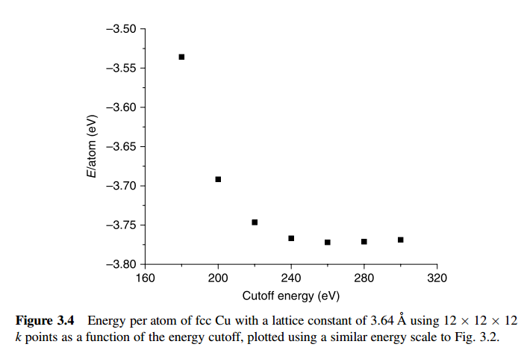
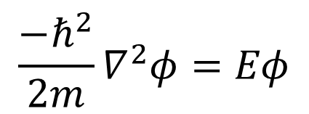
Energy Cutoff – Basis Set Size
$$\frac{{−ℏ}^{2}}{2m}∇^{2}φ=Eφ$$
This should always be monotonic (not like k-points). Why?

Slide 31
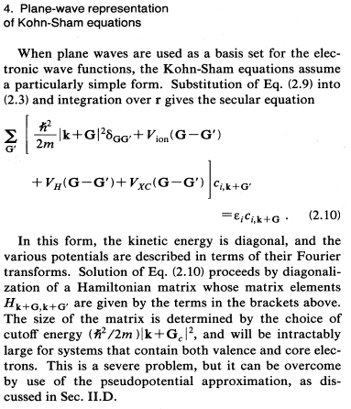
Kohn-Sham equations reduce to a “secular equation” solved with matrix diagonalization

Slide 32
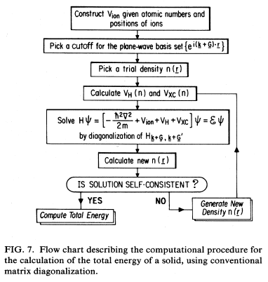
Flow diagram for calculating the electron density at one set of nuclei positions

Slide 33
Flow diagram for calculating the electron density at one set of nuclei positions
Not converged
Pick new nuclei positions and repeat
Check atom forces
Converged
Report optimized energy

Slide 34
What to optimize for a solid? Lattice constant……….
Hands-on session to optimize (manually) lattice constant of a solid

